Slide 1
HOW KERAS LSTM WORKS FROM A PROGRAMMER PERSPECTIVE
Parameters, Structure, Behavior
with
A simple seq2seq Example

Slide 2
A SIMPLE SEQ2SEQ PROBLEM
Given:
[3 5 1 6]
Output
[3 5 0 0]
Task: Remember the first two input and forget the rest.

Slide 3
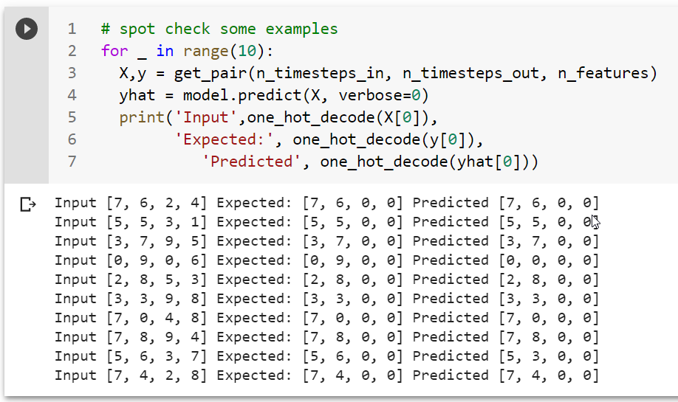
A SIMPLE SEQ2SEQ PROBLEM

Slide 4
A SIMPLE SEQ2SEQ PROBLEM
As usual in NN, we will embed the given integers into some representation: in our case, one-hot-encoded array
Input
[3 5 1 6]
One-hot-encoded :
[[00010000000] [00000100000] [0000000000] [0000000000]]
NOTE: In the following figures, inputs are depicted as integers for the sake of simplicity

Slide 5
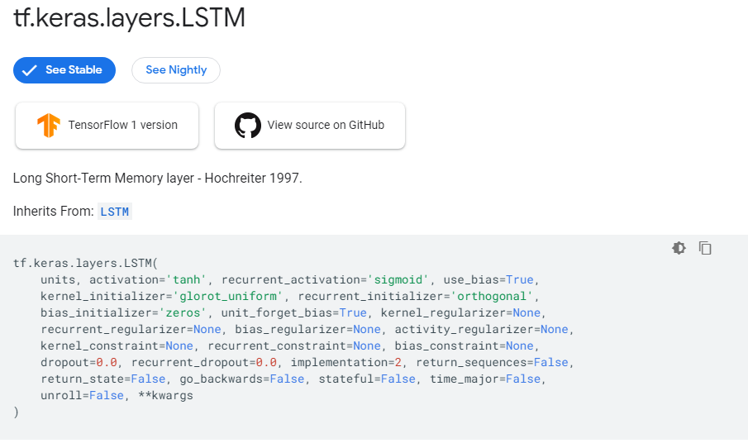

Slide 6
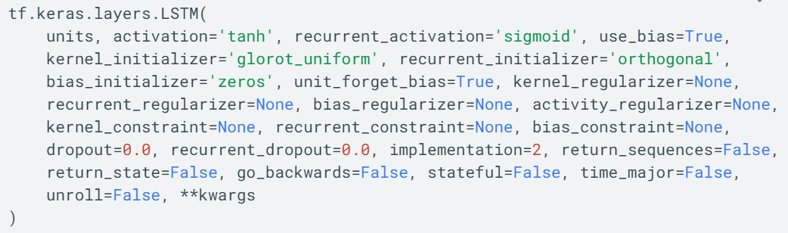

Slide 7
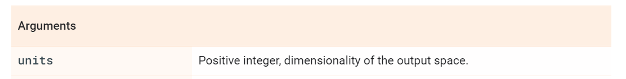
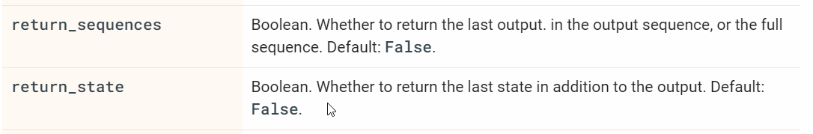

Slide 8
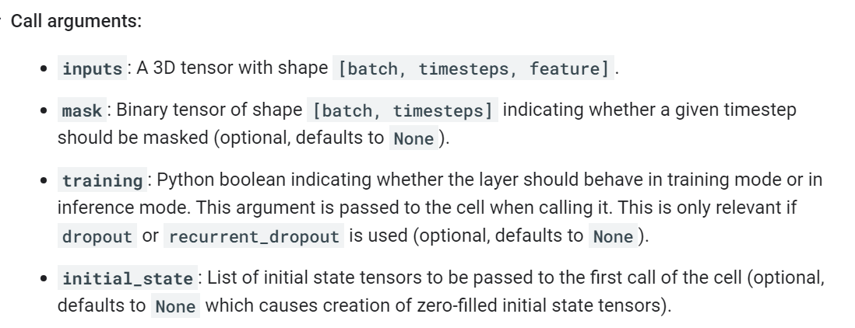

Slide 9
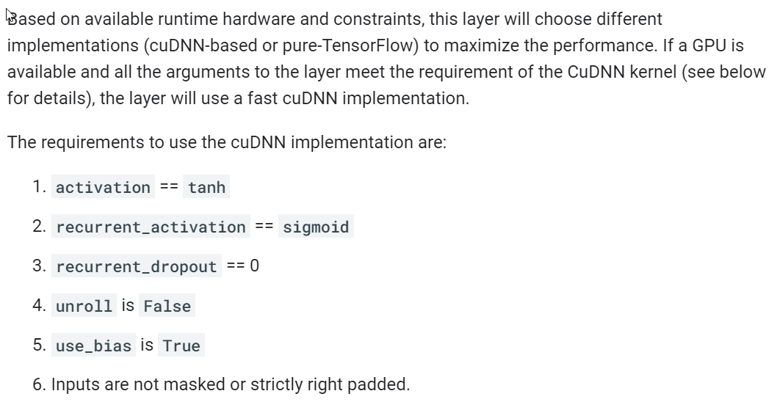

Slide 10
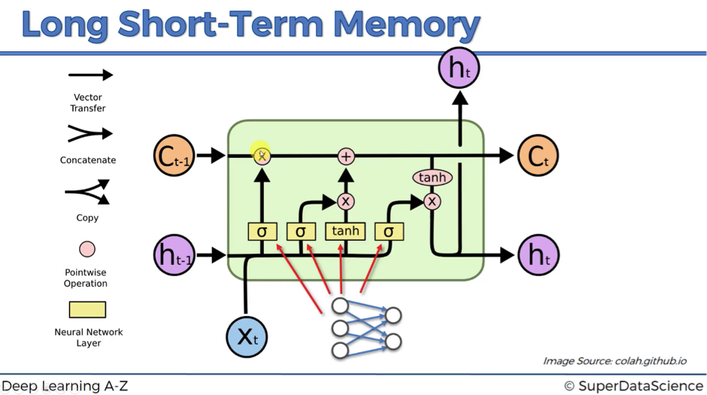
Cell

Slide 11
Cell
Cell State
h_{t} Hidden State

Slide 12
Cell
Cell State
h_{t} Hidden State

Slide 13
Cell
Cell State
h_{t} Hidden State

Slide 14
X = [1,2,3,4]
def LSTMcell (input):
{
C_{t}= random()
h_{t}= f(input, C_{t} )
return h_{t} , C_{t}
}
X₀ = X[0]
h_{1,} , C₁ = LSTMcell(X₀)
LSTM Cell
Cell State
Hidden State

Slide 15
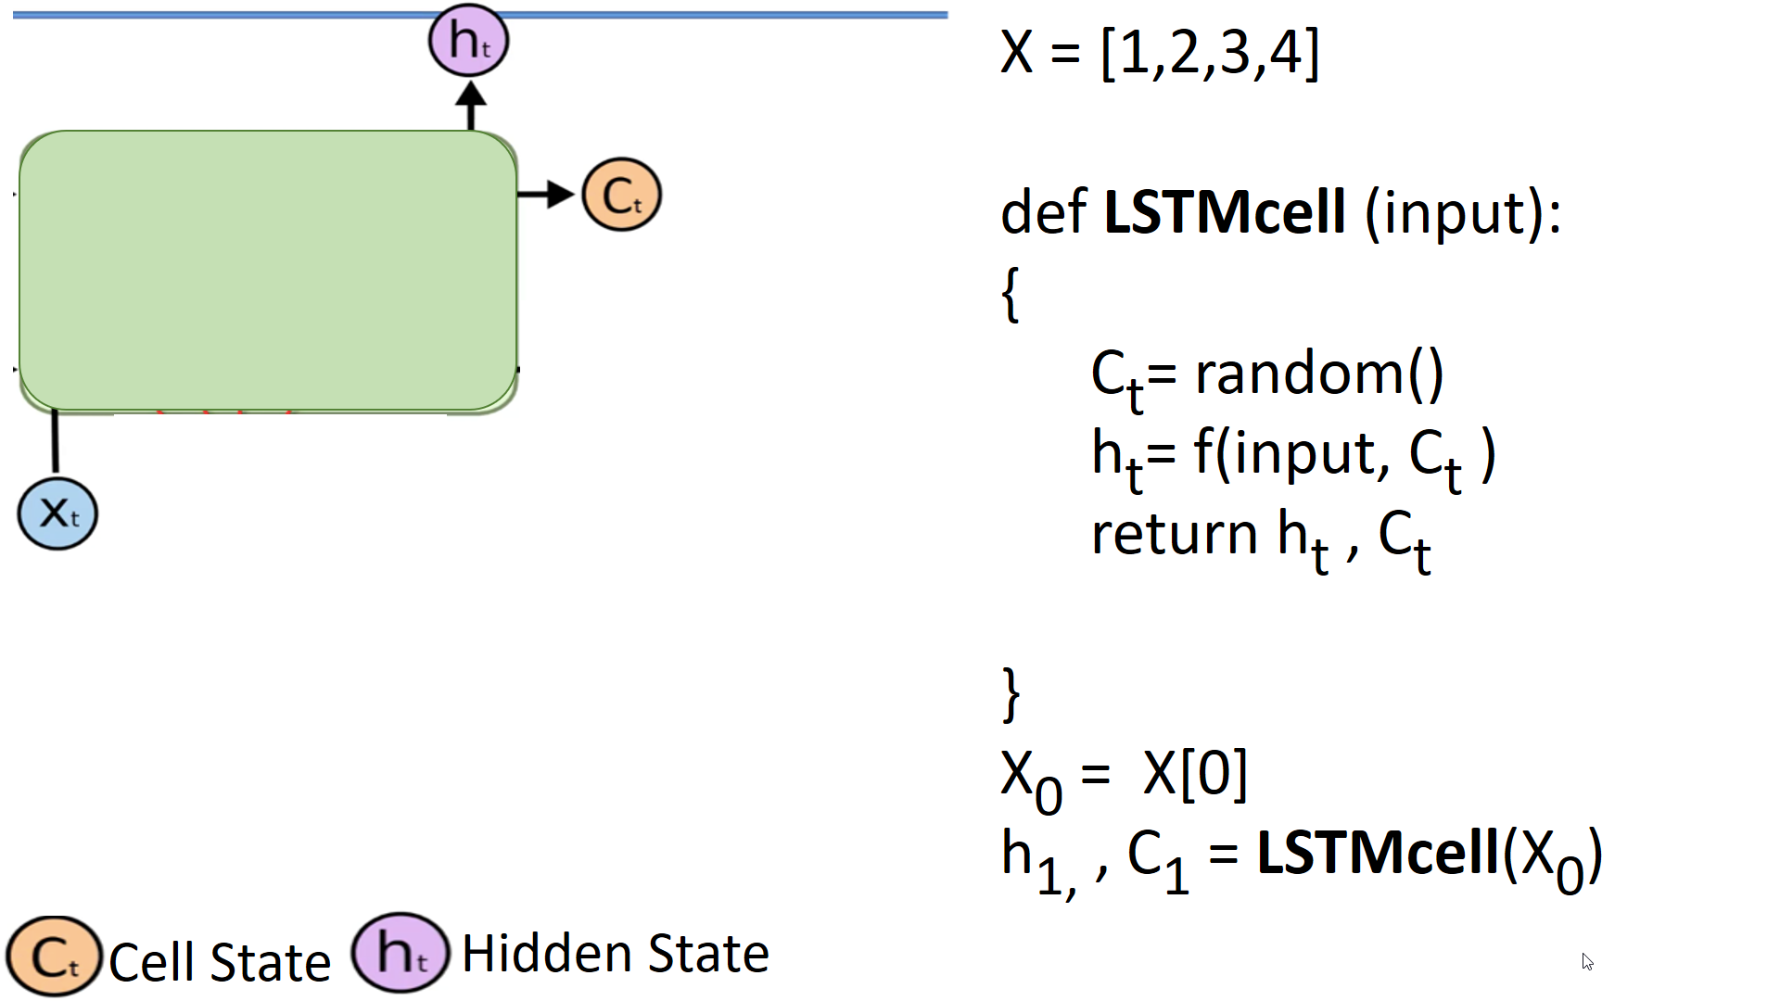
X = [1,2,3,4]
def LSTM_layer (sequence):
{
for x_{t} in sequence:
h_{t,} , C_{t} = LSTMcell(x_{t})
return h_{t} , C_{t}
}
h_{last,} , C_{last} = LSTM_layer(X)
LSTM Cell

Slide 16
X = [1,2,3,4]
def LSTM_layer (sequence):
{
for x_{t} in sequence:
h_{t,} , C_{t} = LSTMcell(x_{t})
return h_{t} , C_{t}
}
h_{last,} , C_{last} = LSTM_layer(X)
h_{last,} , C_{last}
[ 1 2 3 4 ]

Slide 17
X = [1,2,3,4]
def LSTM_layer (sequence):
{
for x_{t} in sequence:
h_{t,} , C_{t} = LSTMcell(x_{t})
return h_{t} , C_{t}
}
h_{last,} , C_{last} = LSTM_layer(X)
But these LSTM cells are oversimplified ☺
h_{last,} , C_{last}
[ 1 2 3 4 ]

Slide 18
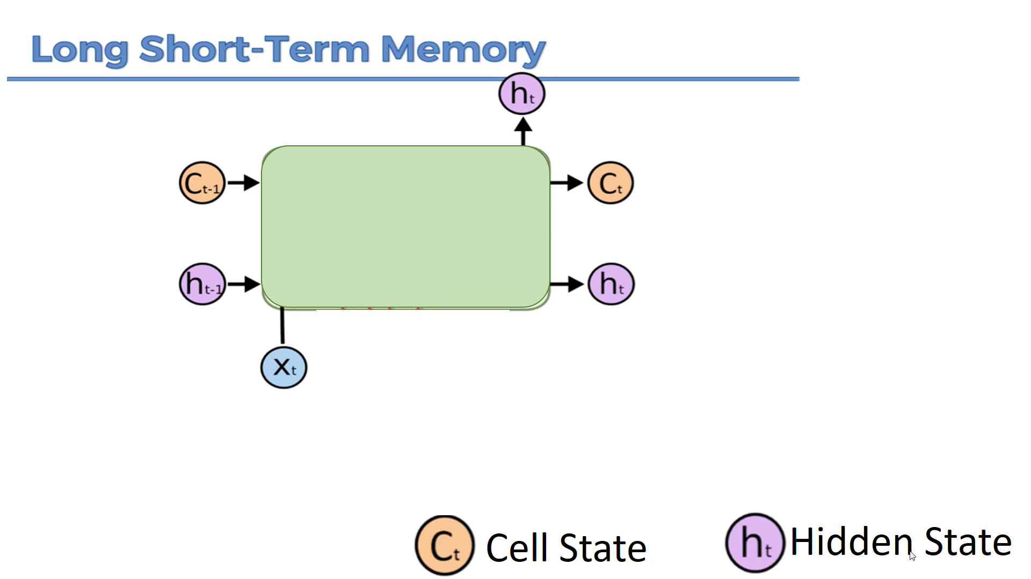
A more realistic one:
Cell

Slide 19
h_{last,} , C_{last}
h_{initial,} , C_{initial}
[ 1 2 3 4 ]

Slide 20
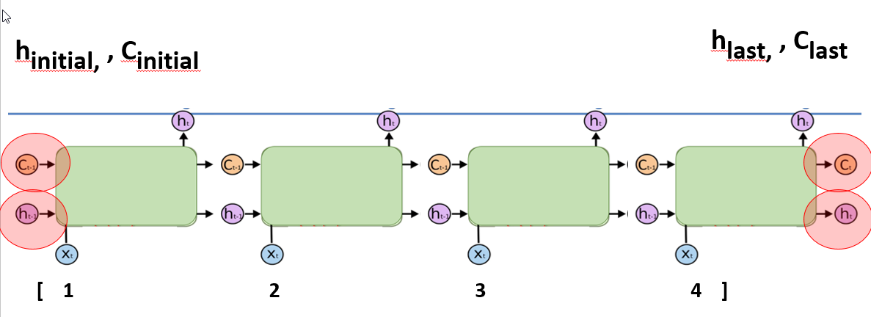
X = [1,2,3,4]
def LSTM_layer (sequence):
{
h_{t,} , C_{t} = random()
for x_{t} in sequence:
h_{t,} , C_{t} = LSTMcell(x_{t}, h_{t,} , C_{t} )
return h_{t} , C_{t}
}
h_{last,} , C_{last} = LSTM_layer(X)

Slide 21
X = [1,2,3,4]
def LSTM_layer (sequence):
{
h_{t,} , C_{t} = random()
for x_{t} in sequence:
h_{t,} , C_{t} = LSTMcell(x_{t}, h_{t,} , C_{t} )
return h_{t} , C_{t}
}
h_{last,} , C_{last} = LSTM_layer(X)

Slide 22
How Many LSTM cells here?

Slide 23
How Many LSTM cells ?
h_{last,} , C_{last}
As many as input time steps?
[ 1 2 3 4 ]

Slide 24
X = [1,2,3,4]
def LSTM_layer (sequence):
{
h_{t,} , C_{t} = random()
for x_{t} in sequence:
h_{t,} , C_{t} = LSTMcell(x_{t}, h_{t,} , C_{t} )
return h_{t} , C_{t}
}
h_{last,} , C_{last} = LSTM_layer(X)
How Many LSTM cells ?
h_{last,} , C_{last}
NO! There is only 1 cell replicating itself!
[ 1 2 3 4 ]

Slide 25
X = [1,2,3,4]
def LSTM_layer (sequence):
{
h_{t,} , C_{t} = random()
for x_{t} in sequence:
h_{t,} , C_{t} = LSTMcell(x_{t}, h_{t,} , C_{t} )
return h_{t} , C_{t}
}
h_{last,} , C_{last} = LSTM_layer(X)
How Many LSTM cells ?
NO! There is only 1 cell replicating itself!

Slide 26
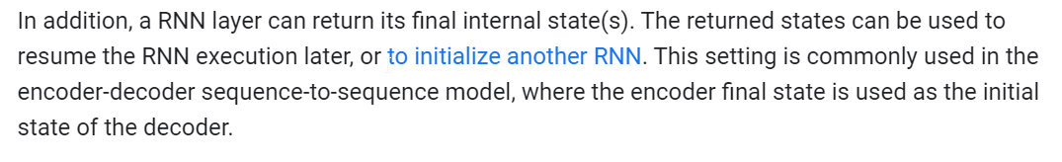
WHAT TO OUTPUT?
[ 1 2 3 4 ]

Slide 27
WHAT TO OUTPUT?
USAGE 1: output only the h_{last,} as the output from LSTM layer
[ 1 2 3 4 ]

Slide 28
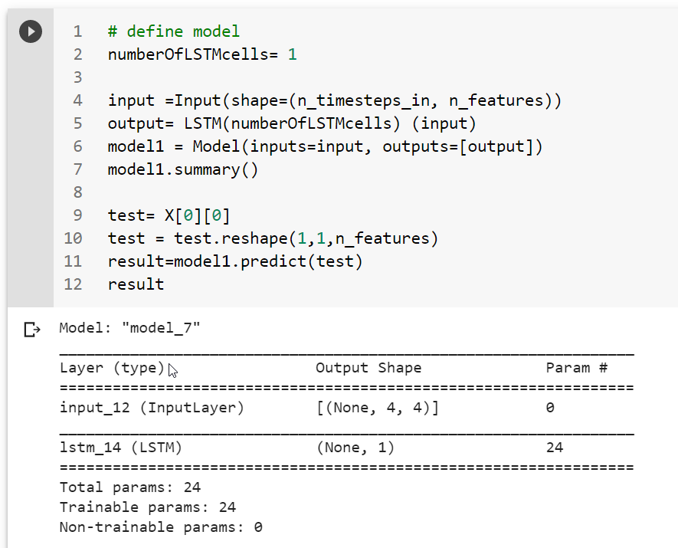
USAGE 1: output only the h_{last,} as the output from LSTM layer

Slide 29
USAGE 2: output all the h_{t,} as the output from LSTM layer
[ 1 2 3 4 ]

Slide 30
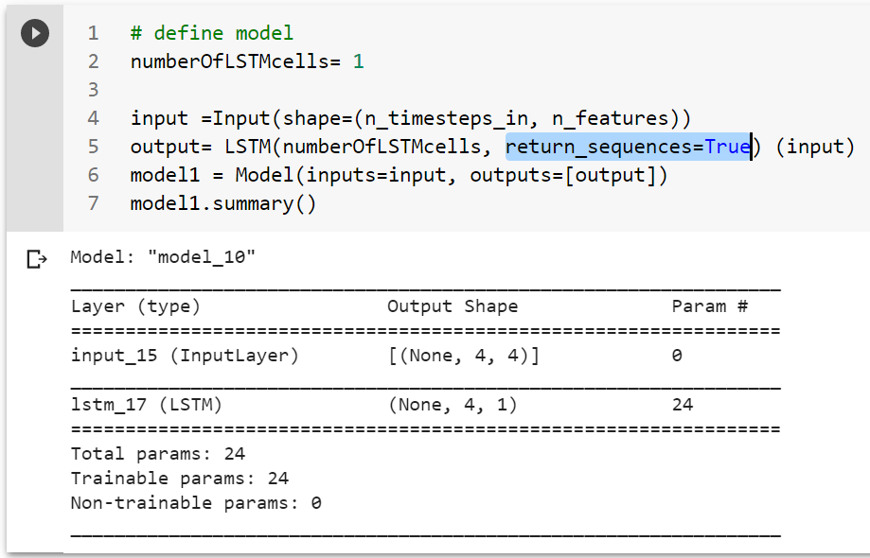
USAGE 2: output all the h_{t,} as the output from LSTM layer

Slide 31
USAGE 3: (Advanced) output the h_{t,} twice, and all C_{t} as the output from LSTM layer
[ 1 2 3 4 ]

Slide 32
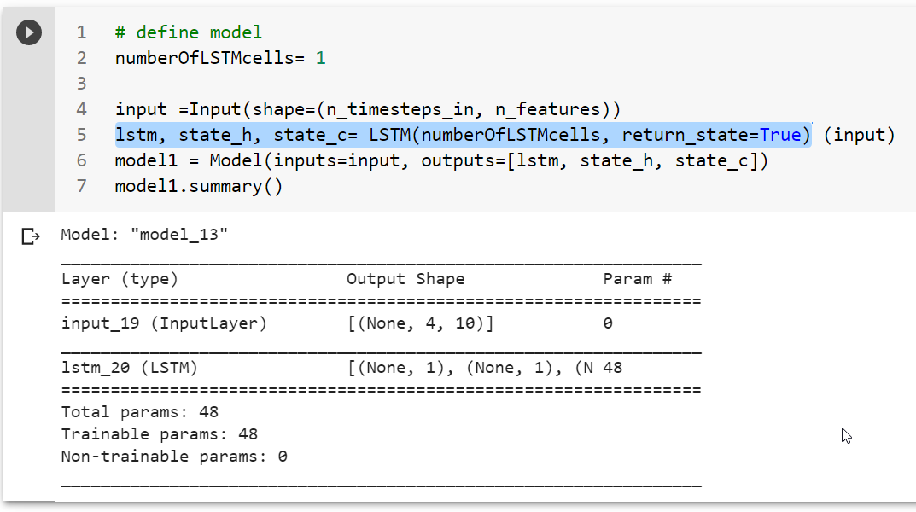
USAGE 3: (Advanced) output the h_{t,} twice, and all C_{t} as the output from LSTM layer

Slide 33
NOTICE: So far in LSTM layer we use only 1 LSTM cell!
[ 1 2 3 4 ]

Slide 34
NOTICE: Now, in LSTM layer we have 2 LSTM cells!
Cell 1
Cell 2

Slide 35
NOTICE: Now, in LSTM layer we have 2 LSTM cells!
Cell 1
Cell 2

Slide 36
NOTICE: Now, in LSTM layer we have 2 LSTM cells!
However, these cells do NOT share any information between them!

Slide 37
NOTICE: What would be the output dimensions for 3 usage cases?

Slide 38
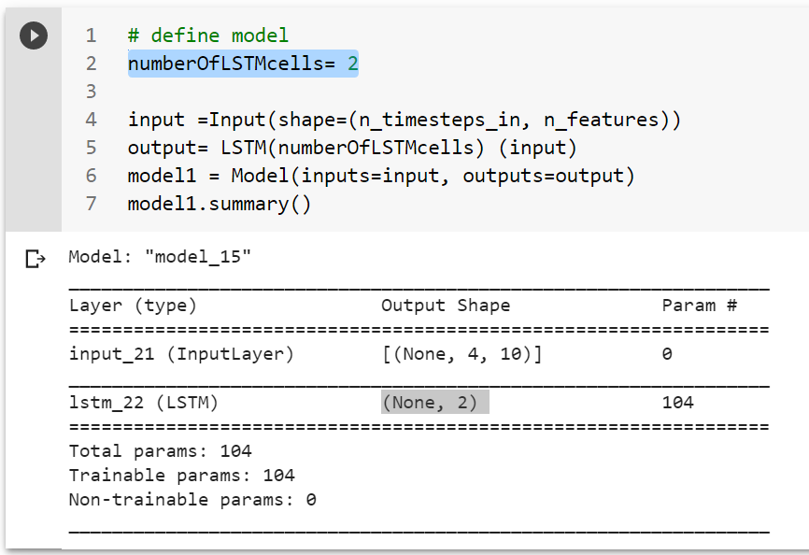
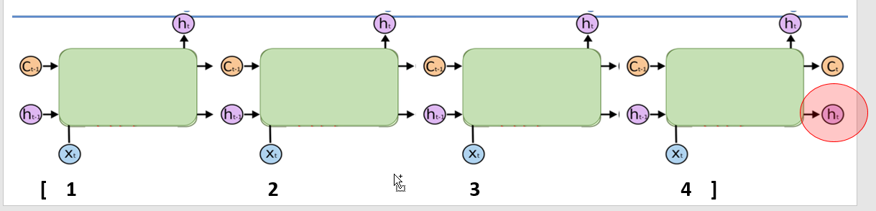
USAGE 1: output only the h_{last,} as the output from LSTM layer

Slide 39
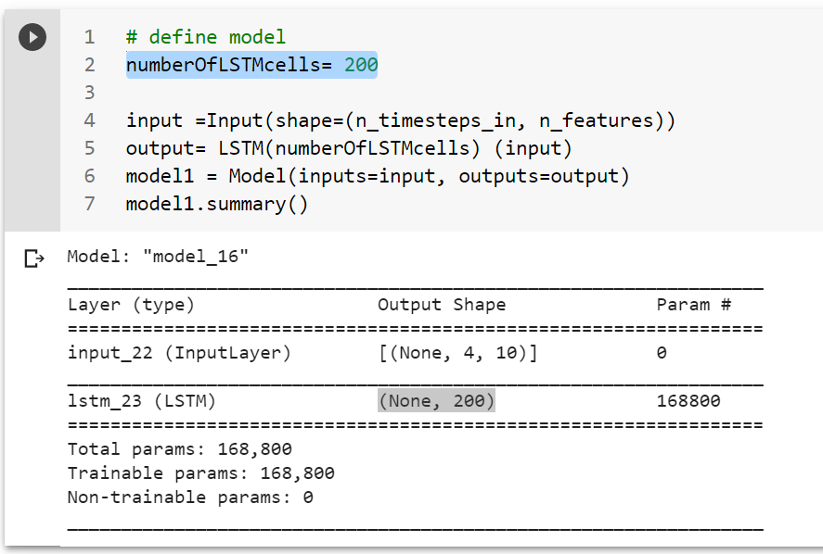
USAGE 1: output only the h_{last,} as the output from LSTM layer

Slide 40
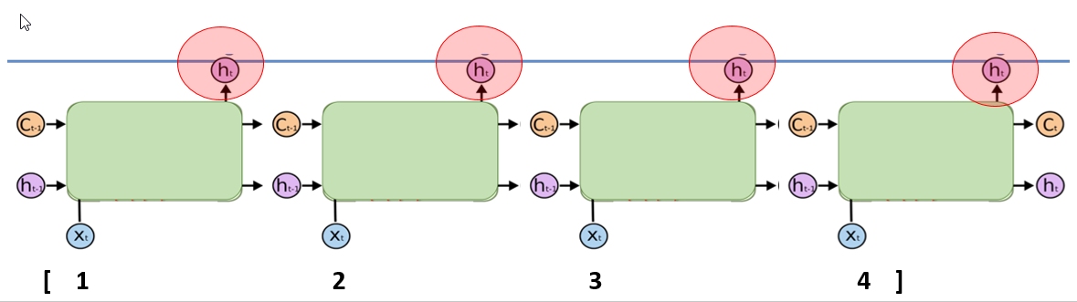
USAGE 2: output all the h_{t,} as the output from LSTM layer

Slide 41
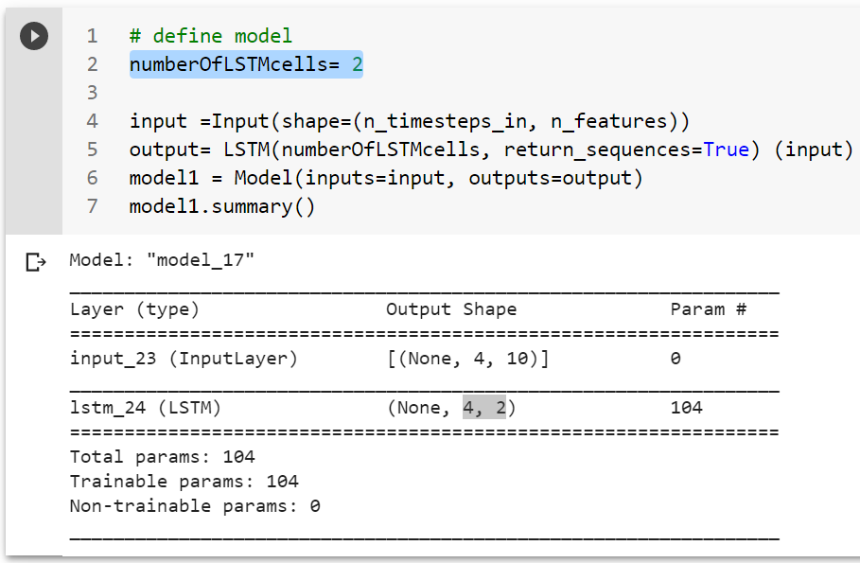
USAGE 2: output all the h_{t,} as the output from LSTM layer

Slide 42
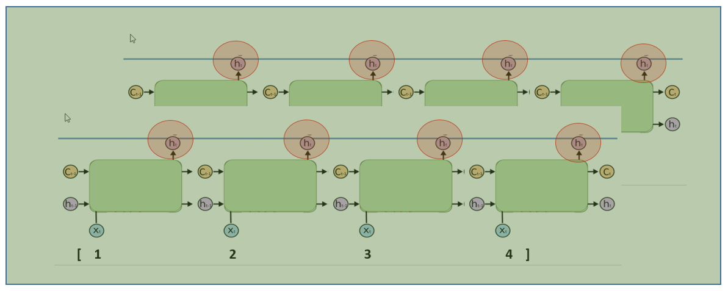
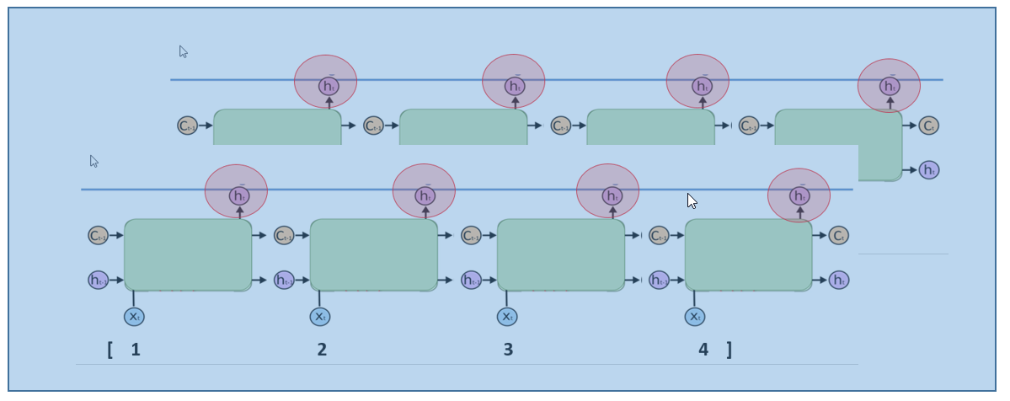
How to stack multiple LSTM layers?

Slide 43
How to stack multiple LSTM layers?

Slide 44
How to stack multiple LSTM layers?
USAGE 1: output only the h_{last,} as the output from LSTM layer

Slide 45
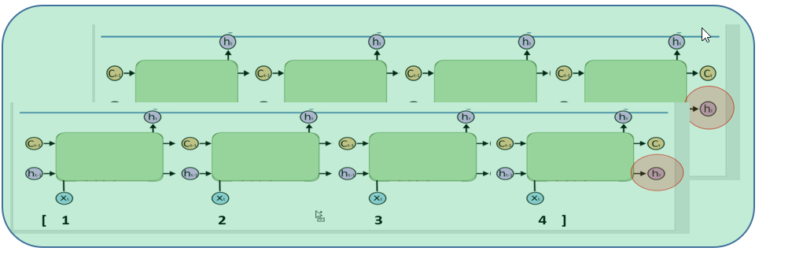
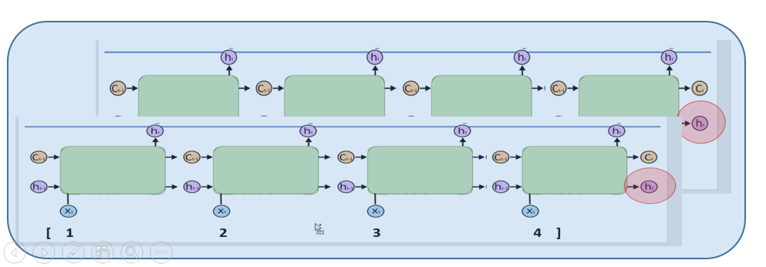
How to stack multiple LSTM layers?
USAGE 1: output only the h_{last} as the output from LSTM layer

Slide 46
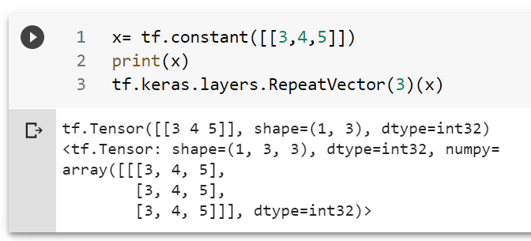
How to stack multiple LSTM layers?
USAGE 1: output only the h_{last} as the output from LSTM layer

Slide 47
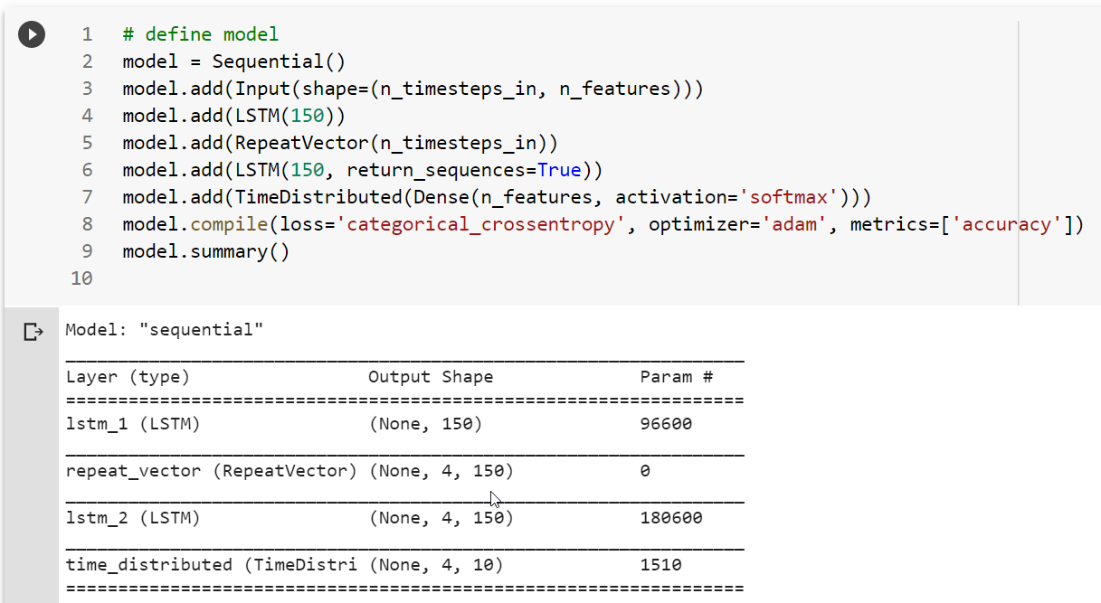
How to stack multiple LSTM layers?
USAGE 1: output only the h_{last} as the output from LSTM layer

Slide 48
How to stack multiple LSTM layers?
USAGE 2: output all the h_{t,} as the output from LSTM layer

Slide 49
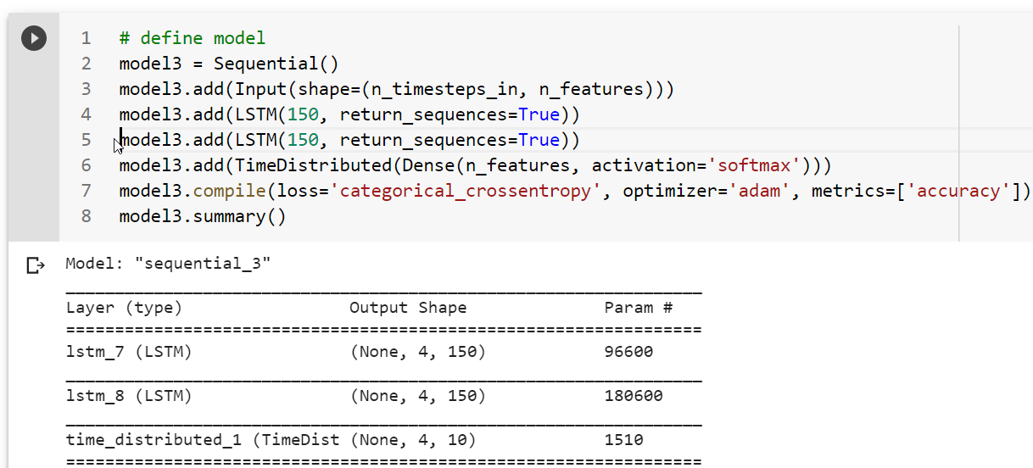
How to stack multiple LSTM layers?
USAGE 2: output all the h_{t,} as the output from LSTM layer

Slide 50
Let’s finalize our code!

